Slide 1
Instructions for running suboptimal alignment
Matthew Chan’s code
PP2
chan250@purdue.edu

Slide 2
Obtain DNA and protein sequences from NCBI
Just used mouse hemoglobin in this example
I have included these fasta files in the submission
Protein: https://www.ncbi.nlm.nih.gov/protein/145301578
DNA: https://www.ncbi.nlm.nih.gov/nuccore/NM_008218.2

Slide 3
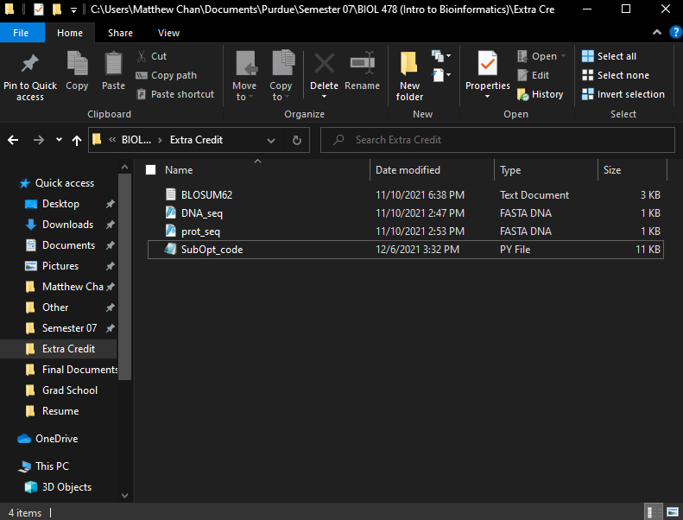
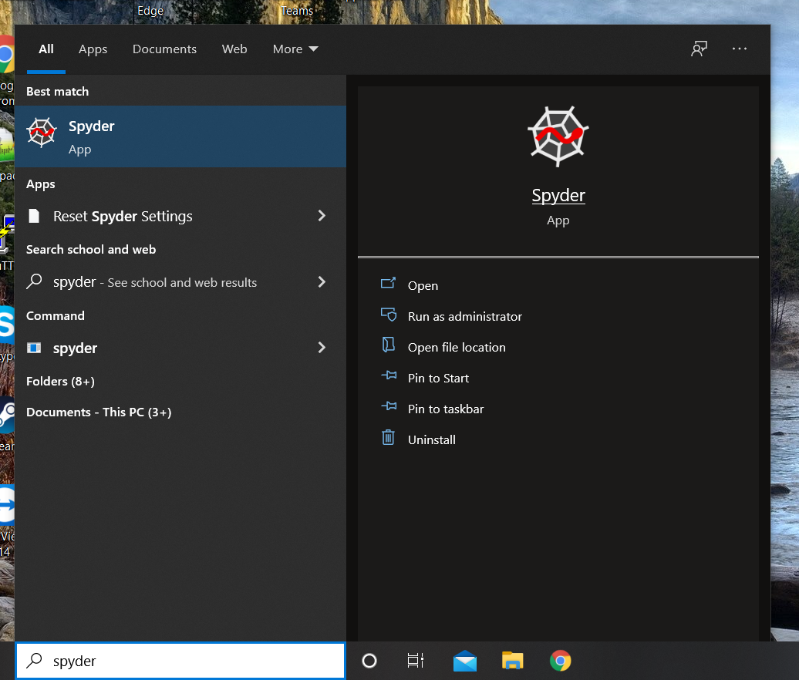
Need something to run Python, I use Spyder
Need following files
BLOSUM62
SubOpt_code
DNA sequence (will be translated and has to be named DNA_seq)
Protein sequence being compared (has to be named prot_seq)

Slide 4
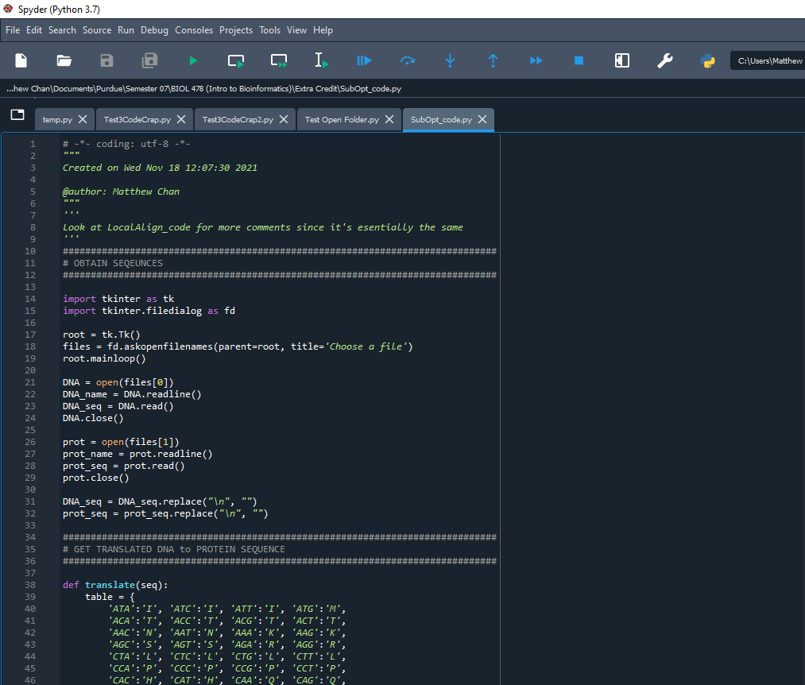
Run code by clicking green play button
Code for sub optimal alignment is very similar to local alignment from PP1

Slide 5
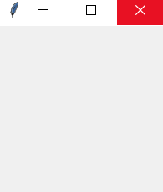
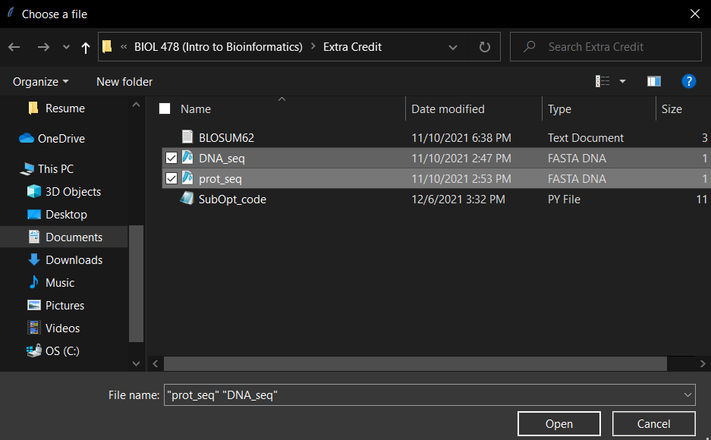
These two windows should pop up
Choose DNA_seq and prot_seq files and click open (Needs to be named DNA_seq and prot_seq exactly)
Make sure to exit the top window too for program to run

Slide 6
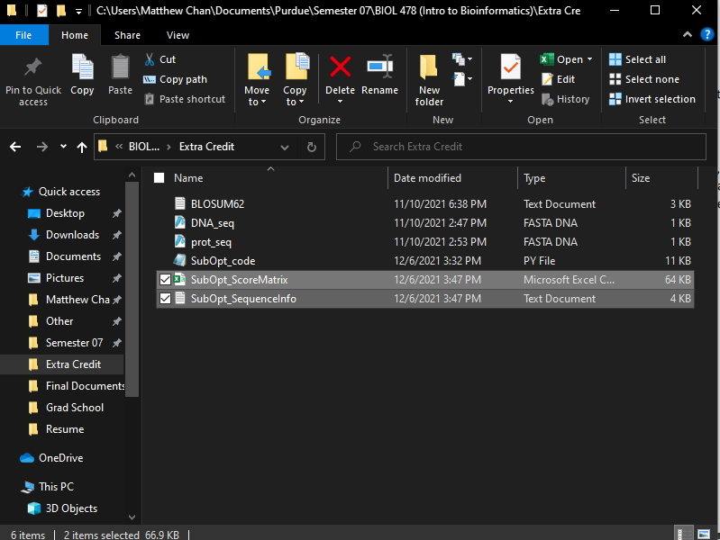
Two new files should appear in folder
SubOpt_ScoreMatrix contains score matrix and traceback
SubOpt_SequenceInfo contains alignment with other additional information

Slide 7
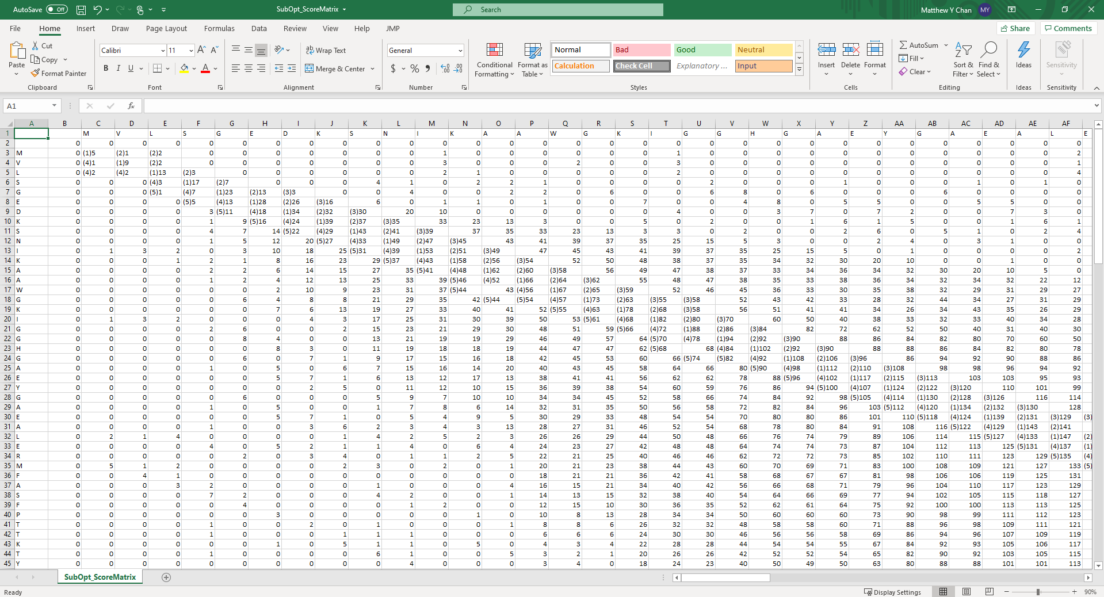
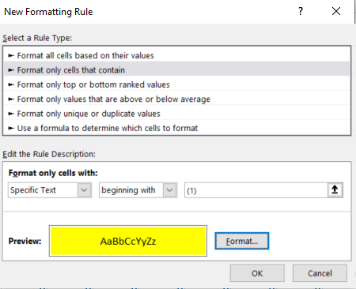
Excel with the score matrix
Traceback marked with (#) (ex. (1)…)
Therefore, ctrl+a; conditional formatting; Highlight cell rules; More rules; and making dialog something like the new formatting rule, you can highlight the traceback in the excel of a certain alignment

Slide 8
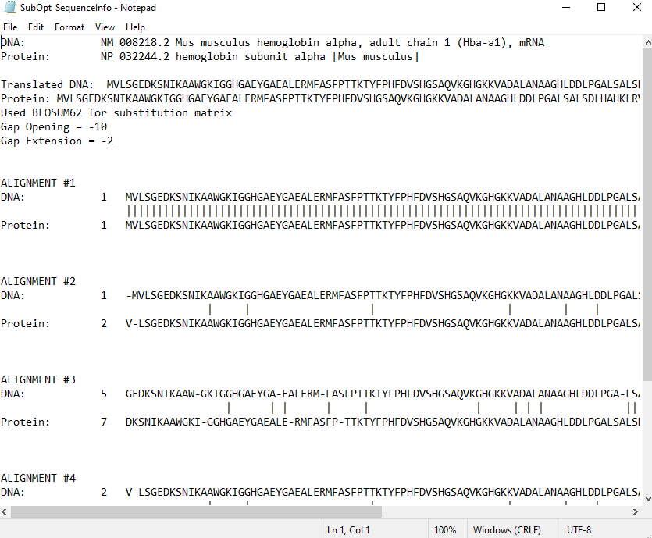
Contains fasta input names taken directly from fasta file
Has the translated protein from the DNA and protein sequence
Includes gap opening and extension values
Includes full alignments of translated protein and protein sequences
Note: it’s not that simple to change from BLOSUM62 to Pam, I just have it print BLOSUM62 was used

Slide 9
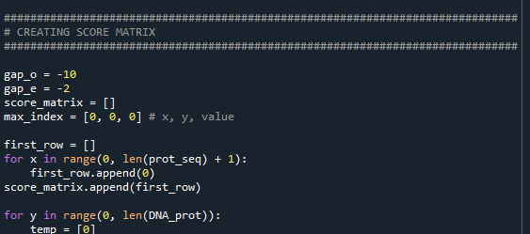
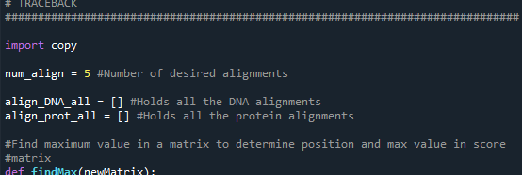
In this part of the code the gap opening (gap_o) and gap extension values (gap_e) can be changed
The number of sub optimal alignments can also be changed by changing num_align value
I don’t foresee anything else that may need to be changed, but if there is please email me and I’ll try to help you understand code. I didn’t comment it well at all.
Since code is almost the same as local alignment, I just used the local alignment code from PP1 so comments should be about the same

